Slide 1
Automated Forex Intelligence & Pricing Platform
Innovative technology enhancing currency pricing accuracy
Prepared by: Paul Wahome, Maryanne Kinyanjui and Simon njoroge

Slide 2
Background / Business Rationale
The bank currently faces challenges in determining competitive yet profitable foreign exchange (forex) rates for customers due to the manual collection, comparison, and interpretation of market information. Treasury and branch teams require timely visibility of market movements, competitor pricing, and reference rates to make informed pricing decisions.
The current process of manually reviewing rates from the Central Bank of Kenya (CBK) and competing banks is time-consuming, prone to human error, and may result in delayed pricing decisions, missed revenue opportunities, or non-competitive customer offers.
This project proposes the development of an automated forex intelligence workflow using n8n automation, API/HTTP data collection, AI-powered data processing, and dashboard visualization to provide hourly forex market insights.
The solution will automatically collect forex rates from:
Central Bank of Kenya reference rates
Five selected competitor banks
Other approved market data sources where applicable
The collected information will be cleaned, validated, analyzed, and presented through dashboards accessible

Slide 3
Project objectives
The objective of this project is to develop an automated forex monitoring and analytics solution that:
Provides hourly visibility of market forex rates.
Enables Treasury to determine competitive customer rates.
Supports profitability decisions through market benchmarking.
Reduces manual rate collection activities.
Improves accuracy through automated validation and error handling.
Creates a reliable audit trail of historical forex movements.

Slide 4
Project Value proposition
Volatile FX Market Context
Kenyan banks face a volatile forex market influenced by import demand, liquidity constraints, and regulatory interventions.
Current Manual Pricing Challenges
Manual forex rate benchmarking causes delays, inconsistencies, and risks of human error in pricing decisions.
Automated Forex Intelligence Platform
The platform automates data collection, validation, and analysis integrating CBK and competitor pricing for reliable market insights.
Strategic and Operational Benefits
The solution enhances competitiveness, protects margins, reduces manual workload, and ensures consistent pricing governance
Buy–Sell Spread Importance
The buy–sell spread is a crucial metric showing the bank’s margin and competitiveness in forex trading.
Variability Across Banks
Spreads differ among Kenyan banks due to liquidity, risk appetite, customer segmentation, and market conditions.
Real-Time Spread Monitoring
Automated near real-time data capture enables treasury teams to quickly detect spread anomalies and market shifts.
Impact on Revenue and Pricing
Accurate spread benchmarking prevents silent losses and helps optimize pricing for better revenue and market positioning.

Slide 5
Key features
Significance of CBK Reference Rate
The CBK reference rate guides pricing and highlights market stress or pricing errors when deviations occur.
Real-Time Rate Gap Monitoring
The platform calculates and visualizes real-time gaps between competitor selling rates and CBK, aiding quick decision-making.
Risk and Pricing Implications
Positive gaps may indicate liquidity scarcity; negative gaps can expose banks to losses from aggressive pricing.
Enhanced Governance and Automation
Automated comparison with alerts improves governance and reduces losses from misaligned pricing decisions.
Intraday USD/KES Volatility
USD/KES rates fluctuate significantly intraday due to market demand, offshore flows, and central bank activities.
Importance of Real-Time Trend Monitoring
Real-time trend tracking enables Treasury to manage timing risk and avoid losses from delayed market reactions.
Informed Decision-Making
Trend visibility helps Treasury adjust rates, widen spreads, and communicate proactively with branches.
Post-Event Data Analysis
Historical intraday trend data supports review and improvement of pricing strategies after market events

Slide 6
Benefits to the bank
Revenue Benefits
Improved forex pricing competitiveness
Better customer retention
Improved spread management
Reduced pricing leakage
Operational Benefits
Elimination of manual rate gathering
Faster Treasury decision-making
Reduced operational errors
Better audit trail
Risk Benefits
Improved market awareness
Faster response to currency volatility
Better governance over customer pricing

Slide 7
Solution Overview
The proposed forex intelligence automation platform will transform forex rate management from a manual, reactive process into a data-driven decision-support capability. By combining n8n automation, AI processing, and dashboard analytics, the bank will improve pricing agility, protect margins, and provide customers with competitive forex offerings.

Slide 8
Step 1: Data Collection Layer
Using n8n HTTP nodes:
Pull forex rates every hour from:
CBK website/data source
Five competitor banks
Capture:
Currency pair
Buying rate
Selling rate
Date/time collected
Source institution

Slide 9
Step 2: Data Quality & Validation Layer
Automation controls will be implemented to prevent inaccurate data from reaching users. Controls include:
Duplicate detection
Missing value checks
Currency format validation
Outlier detection
Source availability monitoring
Timestamp validation
Rate movement threshold alerts
Example rule:
If USD rate changes by more than 5% within one hour, flag for Treasury review

Slide 10
Step 3: AI Processing Layer
AI nodes will:
Clean inconsistent formats
Standardize currency names
Identify market trends
Summarize movements
Example AI output:
"USD/KES market rates increased by 0.8% compared to previous hour. Competitor average selling rate is 129.65. Recommended customer selling rate: 129.55."

Slide 11
Step 4: Dashboard Layer
Dashboard views will provide:
Treasury Dashboard
Metrics:
Current market average
Competitor rates
Bank position
Suggested pricing range
Rate movements
Historical trends
Branch Dashboard
Metrics:
Approved customer rates
Currency availability
Competitor comparison
Rate alerts

Slide 12
Workflow
Schedule Trigger (Hourly)
↓
HTTP Nodes (CBK + 5 Banks)
↓
Merge Data Node
↓
AI Data Cleaning Node
↓
Validation Rules
↓
Error Handling Workflow
↓
Database / Google Sheet Storage
↓
Dashboard Update
↓
Alerts (Email/Teams)

Slide 13
Resilience and Error Management Framework
To ensure reliability, Data Failure Controls will include
Automatic retry if website unavailable
Backup data source
Timeout controls
Failed workflow notifications
Data Accuracy Controls
Rate reasonability checks
Previous-hour comparison
Competitor comparison validation
Manual approval override
Operational Controls will include
Workflow monitoring dashboard
Execution logs
Error queue
Daily system health report

Slide 14
Technology Components
Component | Purpose
n8n | Workflow automation engine
HTTP Nodes | Data extraction
AI Nodes | Cleaning and analysis
Database | Historical storage
Dashboard Tool (Power BI/Looker Studio/Tableau) | Visualization
Email/Teams Alerts | Notifications
Cloud Hosting | Availability

Slide 15
Potential External / Technology Costs
Item | Estimate
n8n cloud/self-hosting | Depends on deployment model
AI API usage | Monthly consumption based
Dashboard licensing | Depends on selected platform
GIT Hub hosting | Monthly subscription/ infrastructure cost
Monitoring tools | Optional

Slide 16
Key Risks and Mitigation
Risk | Mitigation
Website structure changes | Flexible extraction logic
Incorrect source data | Validation rules
AI errors | Human approval checkpoints
System downtime | Retry and fallback workflows
Data security concerns | Access controls and encryption

Slide 17
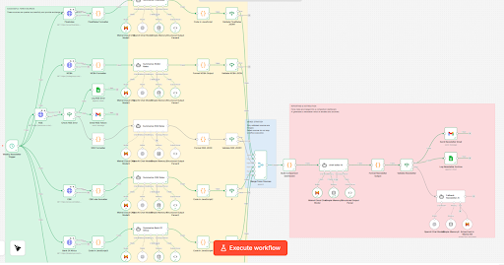
Actual Workflow diagram

Slide 18
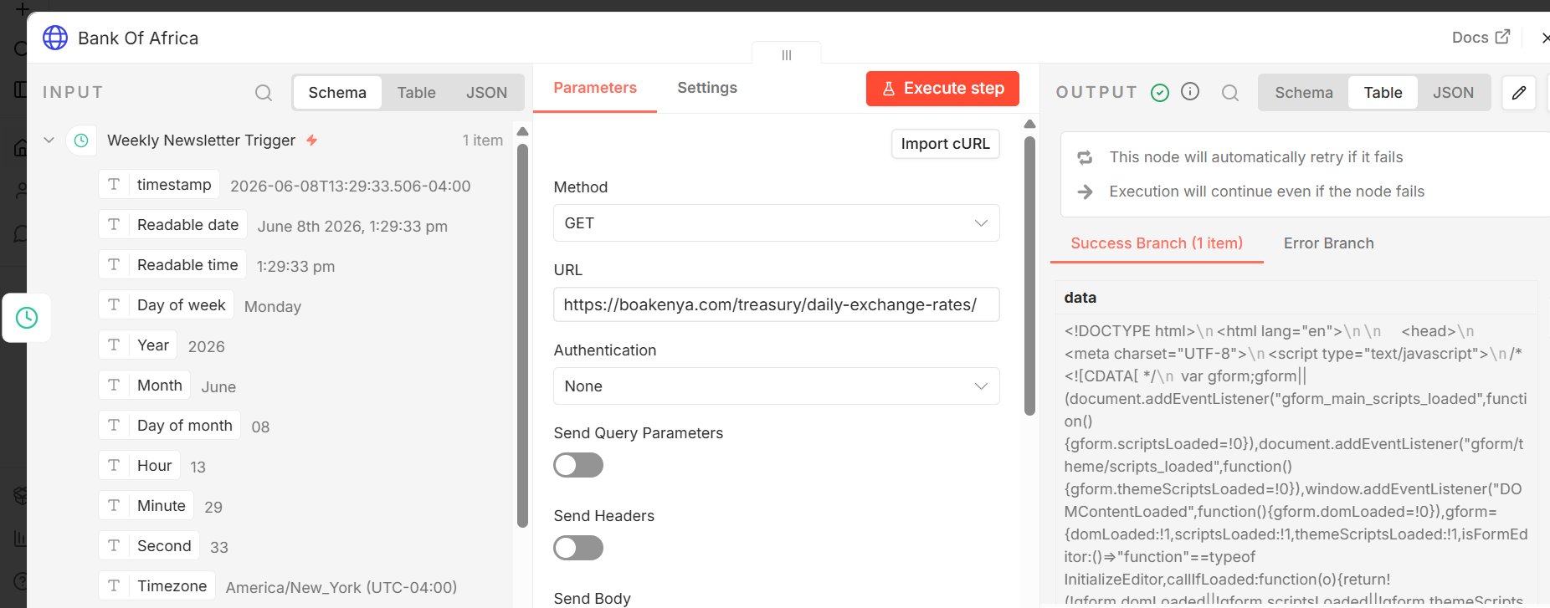
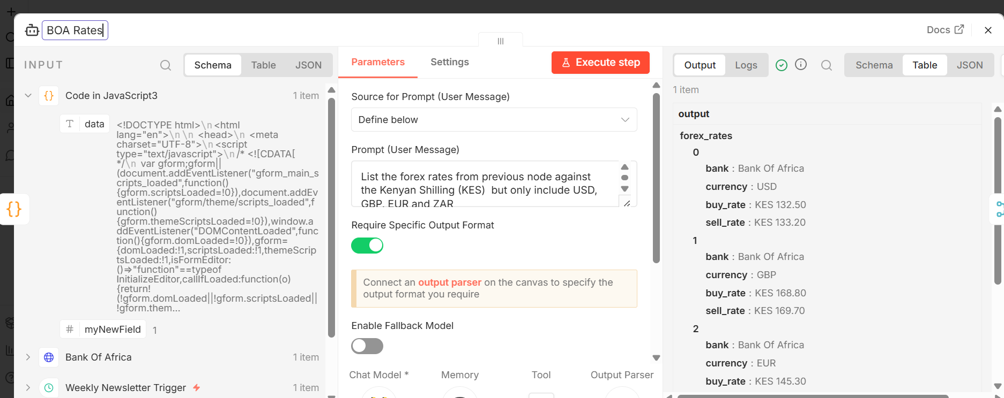
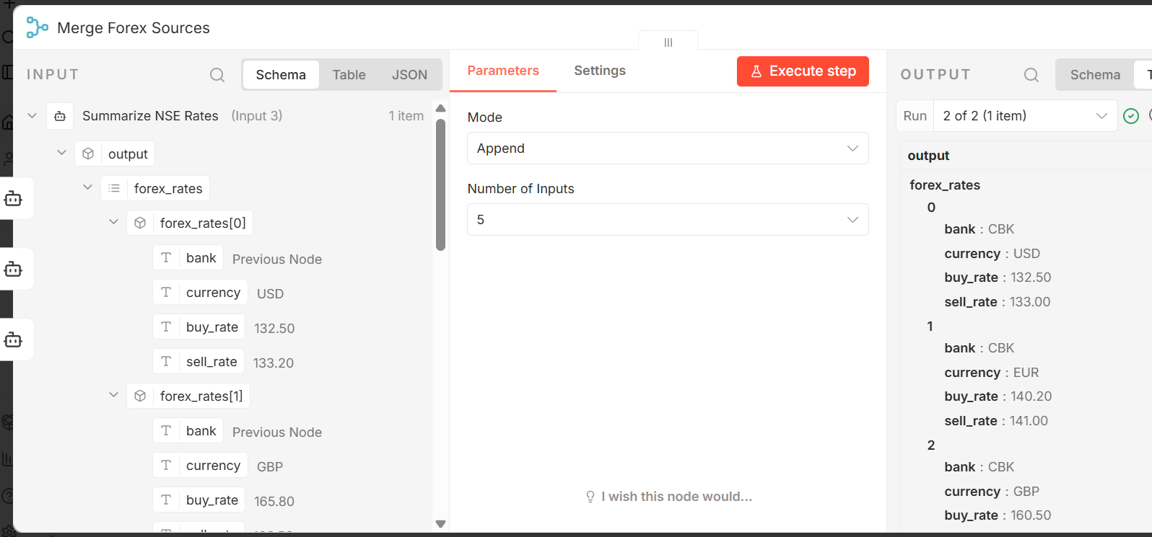
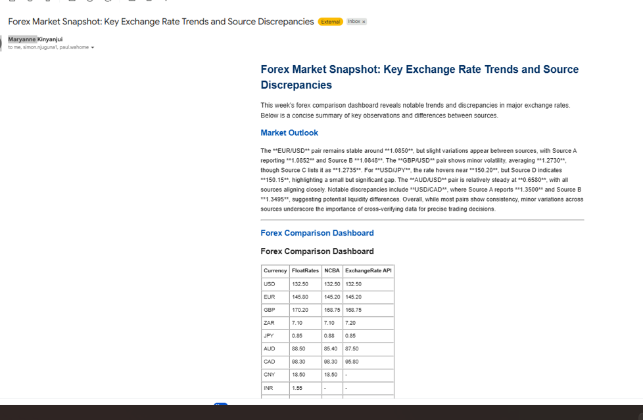
Screen shots

Slide 19
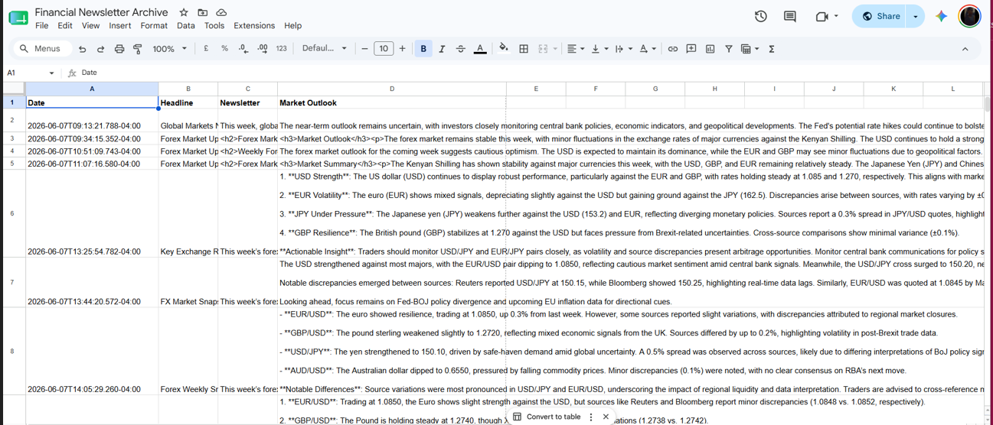
Output screen shots

